Slide 1
Robotic Solar Farm Grass Cutting System Design Challenge (Egoat)
Daniel Corbellini, EE
Tyler Bradley, EE
Joseph Morelli, EE
Nathaniel McKain, CpE
Sponsors: OUC and Duke Energy
Notes:
Daniel

Slide 2
Motivation
Cheaper alternative for solar farm landscape maintenance
Demonstrate knowledge gain from years of studying engineering
Project provides the opportunity to work with engineers of other disciplines
Wanted to have work experience with an autonomous project
Notes:
Daniel

Slide 3
Problems
Expenses from paying workers to cut the grass around and under the solar panels
No need to use chemicals to kill grass directly under the panels
We don’t need goats...
More consistent maintenance of the landscape rather than monthly
Notes:
Daniel

Slide 4
Goals and Objectives
Main goal was to design and build an autonomous rover-based robot to guide electric weedwhackers
Object detection using input sensor
Return to sender
Efficient power supply
Precision, to cut as close to pillars of solar panels
As cost efficient as possible
Notes:
Daniel

Slide 5
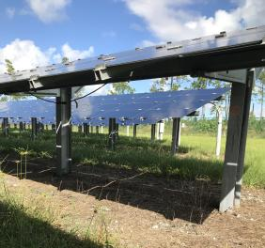
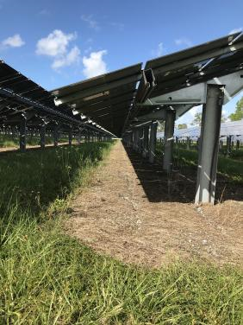
Pictures of Course
Notes:
Daniel

Slide 6
Competition Requirements
Navigation and Mobility
Needs to be able to move autonomously
The ability to traverse over uneven terrain.
Speed and Accuracy
Needs to move fast enough to cut a 50’x10’ area of grass in 15 minutes
Cut grass at a uniform height
Notes:
Joseph

Slide 7
Electrical Specifications
Component | Parameter | Design Specification
Battery | Discharge | 1hr
Remote Kill Switch | Distance | 50ft
Kill switch | Easily Accessible | On Top of Design
Drive Controller | Speed | ~2mph
GPS | Location | 10ft
Fencing | Perimeter | 50x10ft
Notes:
Joseph

Slide 8
Mechanical Specifications
Component | Parameter | Design Specification
Dimensions | Size | 24x24x20in
Trimmer | Material | String based
Trimmer | Grass Length | 3 to 6in
Notes:
Joseph

Slide 9
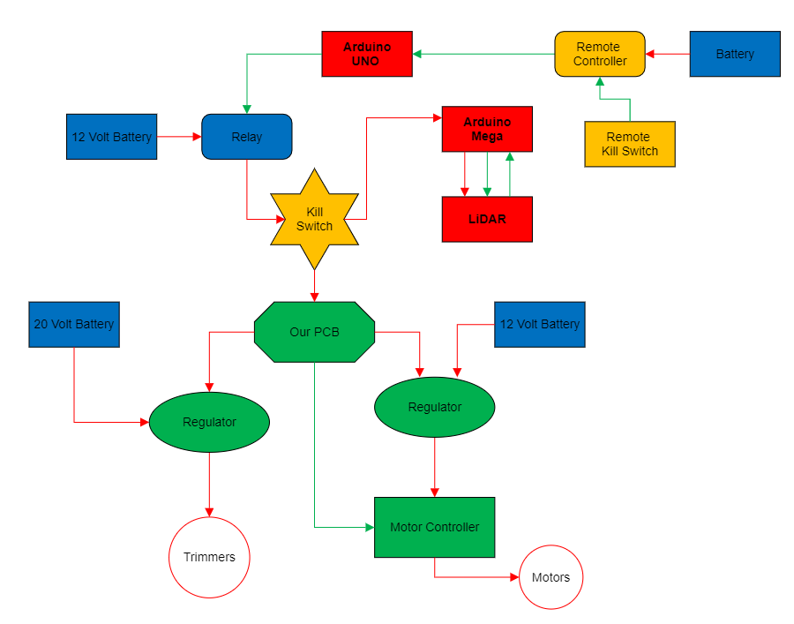
Overall Control System Design
Blue: Daniel
Red: Nathan
Green: Tyler
Gold: Joseph
Arrows
Red: Power
Green: Data
Notes:
Joseph

Slide 10
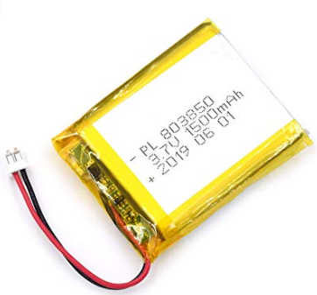
Batteries
Lithium-Ion
High energy density
High charge efficiency
3.7 V
1500mAh
Dimensions of battery
Notes:
LI-ion: used to power the electronics, and emergency system power
Lead-Acid: Used to power Motors and Trimmers
Joseph

Slide 11
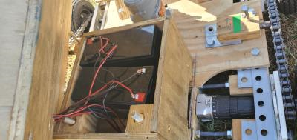
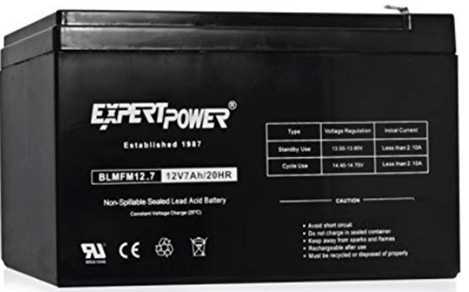
Lead-Acid
Large power-to-weight ratio
Low cost
12 V
7 Ah
Dimensions

Slide 12
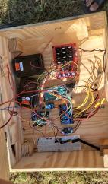
Trimmer Battery

Slide 13
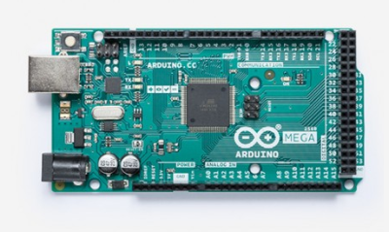
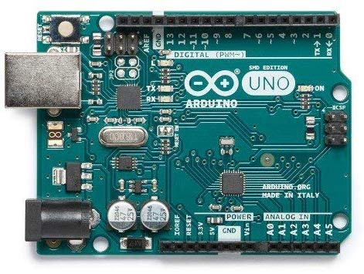
Processor
Arduino Mega 2560
256 KB Flash Memory
Clock speed 16MHz
Operating Voltage 5V
Input Voltage 7-12V
54 digital input/output pins
Arduino Uno
32 KB Flash memory
Clock Speed 16Mhz
14 digital Input/output pins

Slide 14

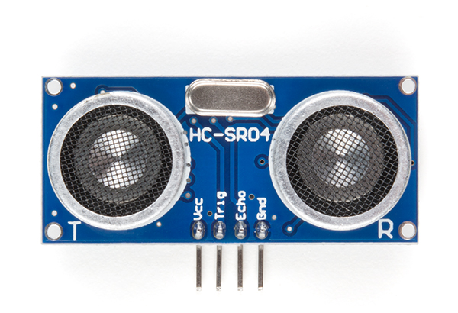
Sensors
RPLidar A1M8
360 degree omnidirectional laser scanner
12 meter range
8000 times sample rate
Configurable Scan Rate from 2-10Hz
Ultrasonic HC-SR04
4 meter range
Back up in case of Lidar Failure

Slide 15
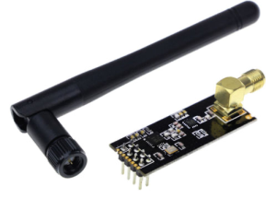
Communication
nRF24L01-RF 2.4GHz Wireless Transceiver Module
Max operating speed 2Mbps
Built-in CRC error detection
Built-in voltage regulator
Low power (1.9-3.6V), only 1uA on Power-down mode

Slide 16
Why we chose rf
Because nigga

Slide 17
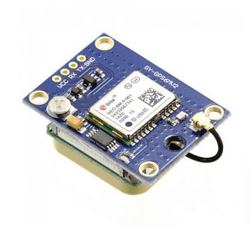
GPS
NEO-6M GPS Module
On board memory chip
Back up battery
Integrates with a broad range of microcontrollers
Cost effective

Slide 18

Fencing
Perimeter around entire course to ensure we stay in bounds
Wire Generator – 555 Timer based circuit to a desired frequency
Frequency Sensor – LC tank circuit will resonate with generated frequency
Multiple sensors around eGoat
Signal detection will allow us to calculate orientation or wire

Slide 19
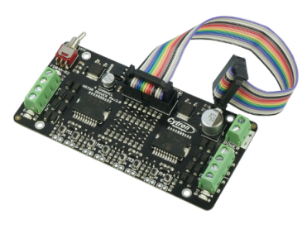
Drive Motor controller
Cytron 4 Channel
Bidirectional control for 4 brushed DC motors
Operating Voltage 7V to 25V DC
Has buttons for quick testing
LEDs for motor output state
Inputs compatible with Arduino

Slide 20
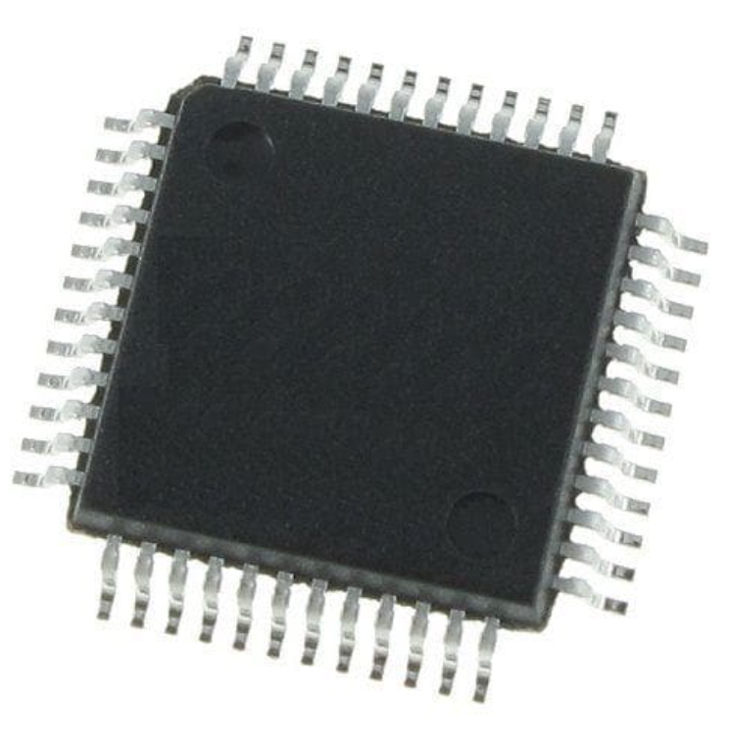
STM32
72 MHz frequency performance
128 Kbytes of Flash memory
26 I/O pins
9 communication interfaces
Low power mode

Slide 21
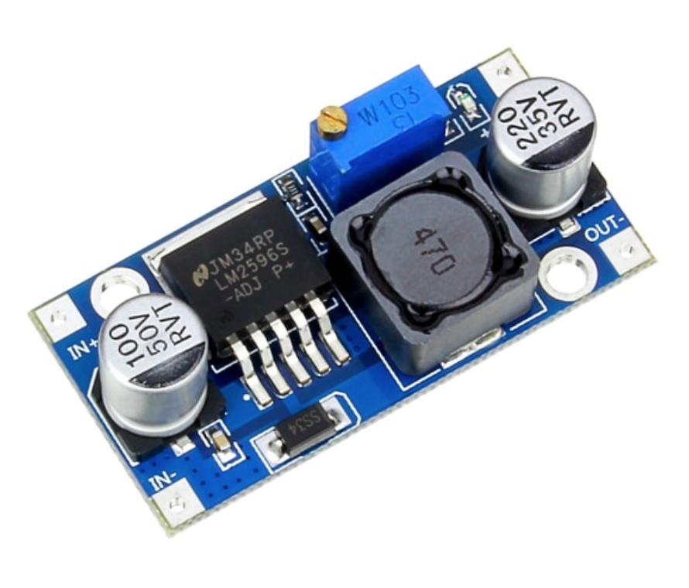
LM2596
Switching voltage regulator
High current load with adjustable output voltage
Highly efficient and simple
Thermal shutdown and current limit protection

Slide 22
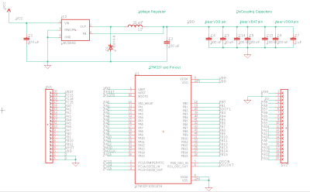
PCb Schematic

Slide 23
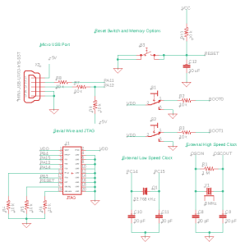
PCB Schematic

Slide 24
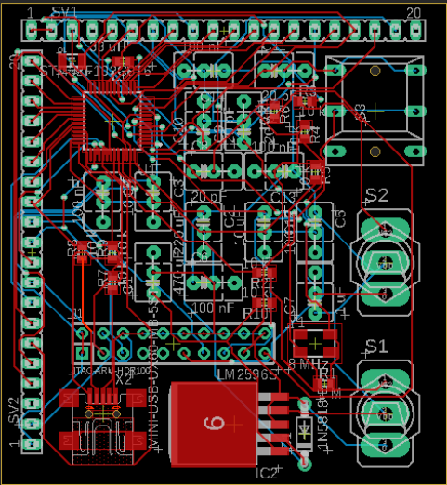
PCB Layout

Slide 25
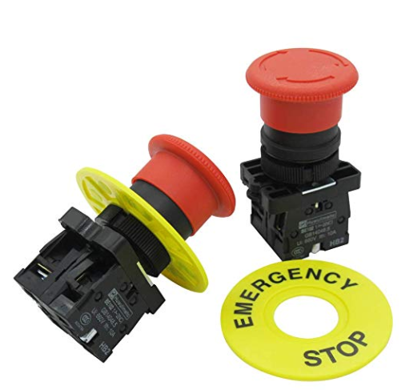
Safety Features
Kill switch on robot and RF kill switch
On board kill switches are Red Mushroom Emergency Stop Push Button Switch
Required to have both types of switches by employers
Perimeter fencing
Activates in less than 1s

Slide 26
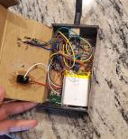
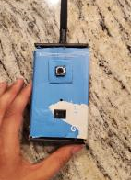
Remote Kill switch
How long takes to work
How made

Slide 27
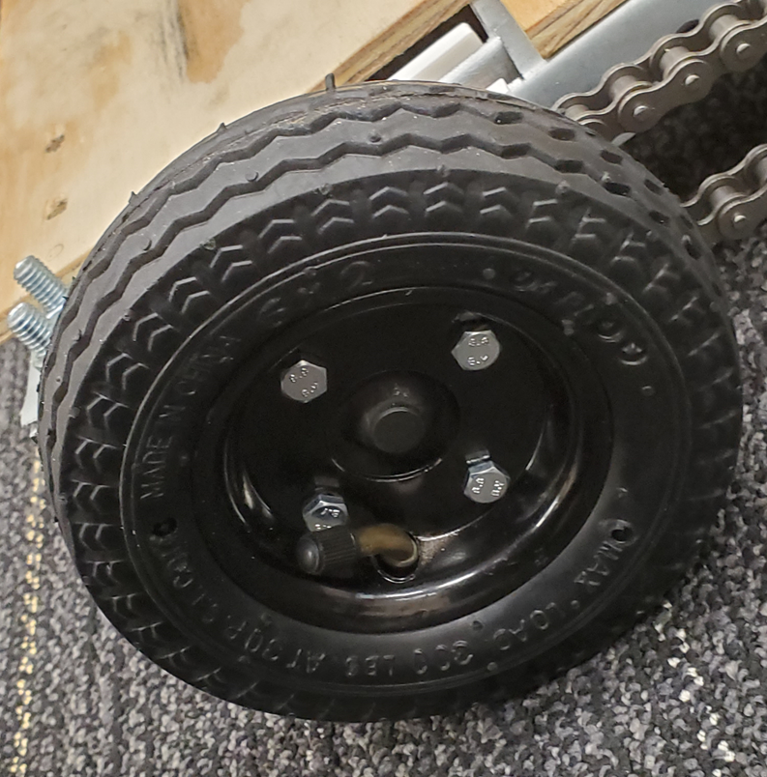
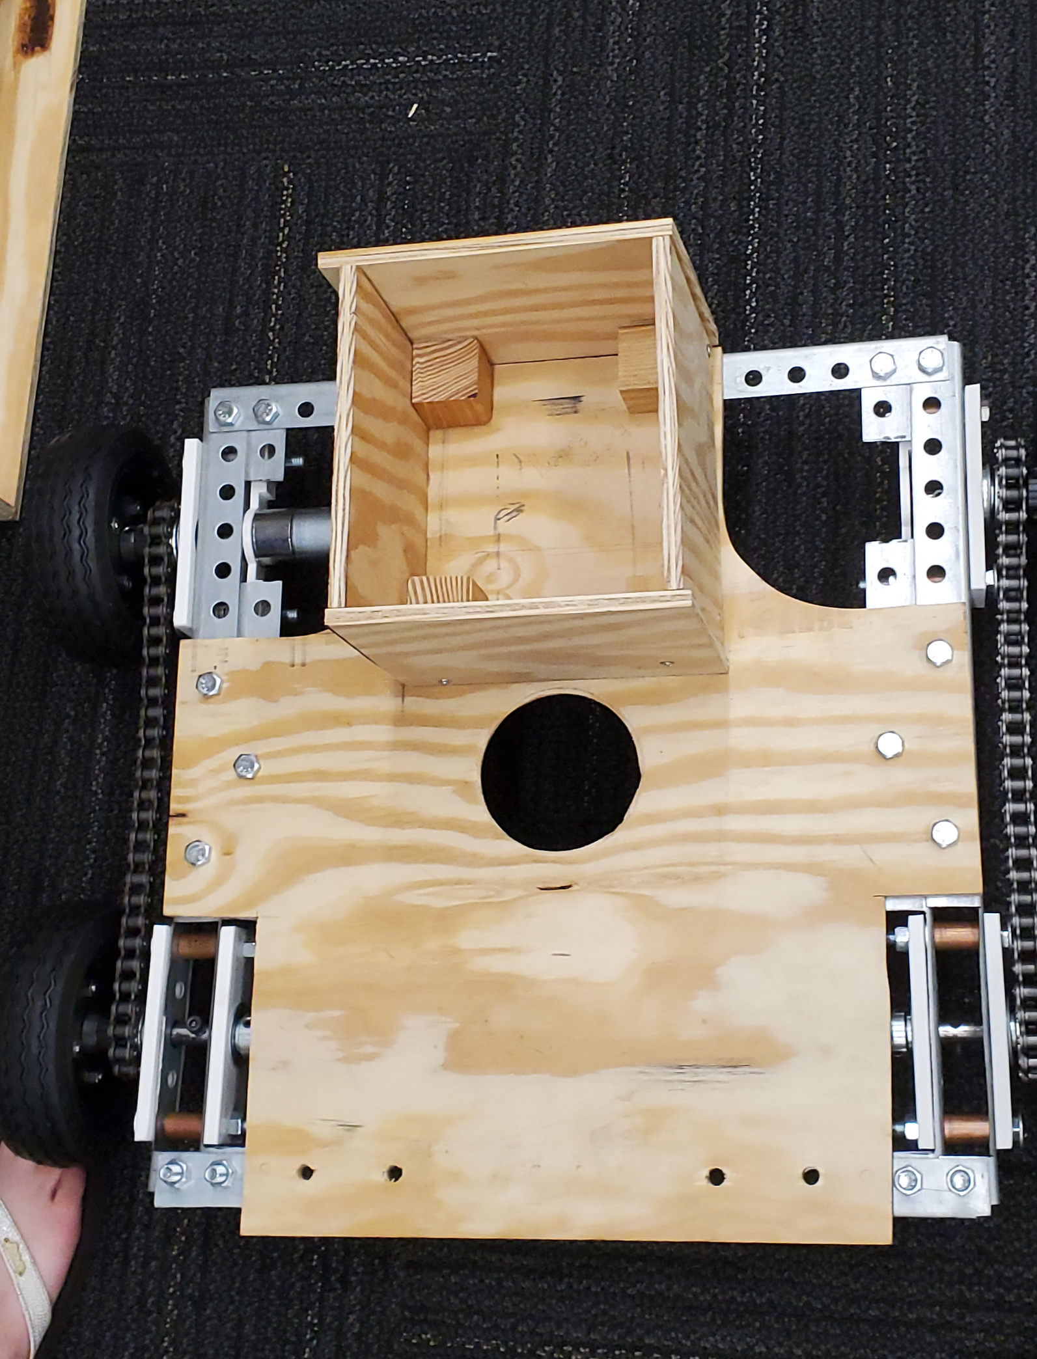
Mechanical Overview
Frame made out of aluminum
Plywood used for surface structures
3 Trimmers- 2 in the front, one in the middle
Small box is for batteries
Large Box houses the electronics
4-Wheels, 6in diameter
Each side connected with a chain.
Treaded rubber wheels

Slide 28
Budget
Item | Quantity | Unit Price | Total Price
Arduino Mega 25600 R3 | 1 | $38.50 | $38.50
Arduino Uno R3 | 1 | $22.00 | $22.00
Arduino Motor Shield R3 | 1 | $22.00 | $22.00
Emergency Stop Button | 1 | $11.99 | $11.99
3.7V Li-Ion battery | 2 | $7.99 | $15.58
12V 7Ah Lead-Acid Battery | 2 | $17.75 | $35.50
DC-DC Voltage Regulator | 1 | $5.99 | $5.99
Transceiver Module | 1 | $9.99 | $9.99
DC Motor Controller | 1 | $34.95 | $34.95
GPS Module | 1 | $16.99 | $16.99
RPLiDAR | 1 | $99.99 | $99.99
Total Electronic |  |  | $313.48
Total Spent |  |  | $1,059.02

Slide 29
Work distribution
Name | Power | Sensors | Software | PCB
Daniel | X |  |  | X
Tyler |  |  | X | X
Joseph | X | X
Nathan |  | X | X

Slide 30
Project Progress

Slide 31
Issues
Interdisciplinary
1
PCB Design
2
Ordering Process
3
Late Start
4

Slide 32

Questions?

